Slide 1
Kempley Parish Council
September 2022
Martin Brocklehurst Chair
martin.brocklehurst@me.com
Climate Report Update
Carbon Footprint Report
Kempley
19th September 2022

Slide 2
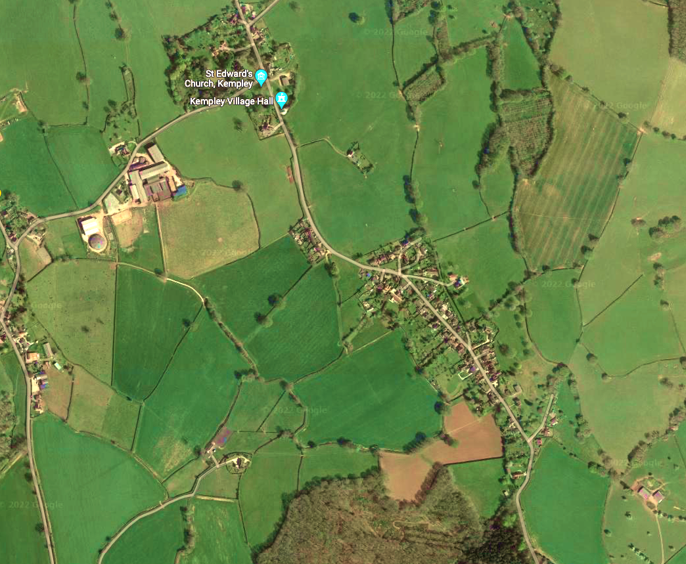
Parish of Kempley
Precept circa £6,000
Population 285
64% working age
23% retired
13% under 16
RURAL
Area – 1,680 acres (680 Ha)
No permanent services
Buses – 2 a week each way
No permanent shops
Rural dispersed community
Norman Church & 12th c Frescoes
Cider Orchards
Wild Daffodil Meadows

Slide 3
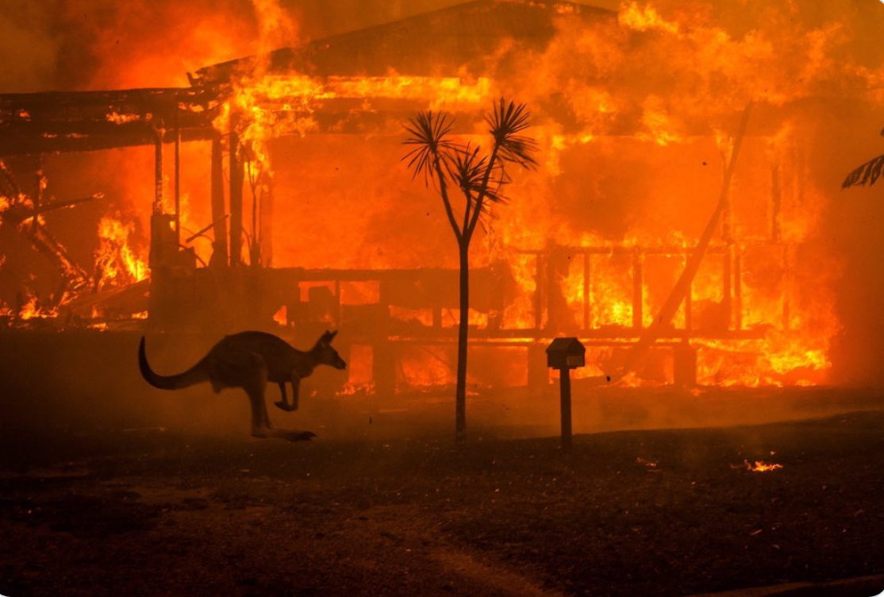
KEMPLEY PARISH COUNCIL
CLIMATE EMERGENCY DECLARED
OCTOBER 2019
ONE WORLD
Carbon Reduction plan
Baseline carbon emissions
Showcase best examples of carbon reduction programmes
Promote grants that support carbon reduction
Promote modernization of broadband
Success
Carbon base line established
Understanding local needs
Attracting £0.5m to modernize broadband to the Parish
Promoting EU £3m AURORA Project
EU Green Deal £0.8 billion investment
Research Knowledge
AUSTRALIAN BUSH FIRES 2019/20 - THE WORST ON RECORD

Slide 4
Carbon Footprint for Kempley
IMPACT Tool – Whole Footprint
Measured in tonnes
From personal activities within the parish by parishioners

Slide 5
Carbon Footprint for Kempley
IMPACT Tool – Whole Footprint
Measured in tonnes
From personal activities within the parish by parishioners
Notes:
How do we compare - Your community’s residents’ use of energy in their homes results in annual carbon
emissions per household of 9.6 t CO e. This compares with 5.1 t CO e at the district
level and 3.5 t CO e at the national level.
How can we change these numbers
What type of housing is there in your community? And what is the main heating fuel
(oil, gas, electricity, etc.)?
Is the housing easily retrofitted to improve how well it retains heat and install low
carbon heating? Do you know if residents are doing this? Do you think there are
community initiatives that could encourage and support residents to do this – e.g. a
green open homes event?
What opportunities are there to retrofit community buildings?
To focus your efforts: many homes, public and commercial buildings have an Energy
Performance Certificate (EPC) which measures the energy efficiency of the property.
You can look at the EPCs of the buildings in your community here:
https://epc.opendatacommunities.org
Could the parish council or groups in your community run an event to share learnings
between residents and building managers who have made changes, such as through
an ‘open homes’ event?
Has your community explored the possibility of a community renewable energy
scheme, such as a solar farm or wind turbine?
Are there opportunities to shift households in your community onto green energy
tariffs, where energy is generated from renewable sources?

Slide 6
Forest Climate Group Event 5th March 2022
Carbon Footprint for Kempley
IMPACT Tool – Whole Footprint
Measured in tonnes
From personal activities within the parish by parishioners
Notes:
How do we compare
Car use: Residents’ car use results in annual carbon emissions per household of 2.5 t
CO e. This compares with 2 t CO e at the district level and 1.6 t CO e at the national
level.
Air travel: Residents’ air travel results in annual carbon emissions per household of 2.1
t CO e. This compares with 1.4 t CO e at the district level and 1.1 t CO e at the
national level.
Public transport: Residents’ use of public transport results in annual carbon emissions
per household of 0.6 t CO e. This compares with 0.5 t CO e at the district level and
0.5 t CO e at the national level.
What can we do
How does your community’s car use-related emissions compare to public transport
emissions? And how do these both compare with the national averages? What might
the reasons be for the differences?
Do you think community schemes could help residents shift their transport behaviours
to using public transport (if this is a choice) or more active travel options (e.g. electric
bike hire or subsidised purchase schemes)? These are already being trialled in
communities across England – look at Hook Norton community’s e-bike scheme and
electric car club for inspiration: https://www.hn-lc.org.uk/electric-bikes
What is the provision of walking and cycling routes through your community and to
local service centres?
What do you think are the key reasons for air travel in your community? It is good to
remember that about 10% of England’s population take more than half of all
international flights – so trying to address ‘frequent flying’ is a good way to target any
activities or communications campaign

Slide 7
Carbon Footprint for Kempley
IMPACT Tool – Territorial Footprint
Measured in tonnes
From All activites within the Parish
Notes:
Are there particular sectors which account for a high proportion of the territorial
emissions in your community?
Based on your knowledge of your local area, are these sectors surprising or what you
would expect?
Who are the key stakeholders you would need to engage with to address the
emissions from this sector, and is this actionable by residents in your community? For
example – for agricultural emissions can you engage with local land owners, or the
NFU/other farmer groups to understand what is happening in your area to reduce
emissions from agriculture? For industrial and commercial emissions, can you speak
with the Chamber of Commerce or council about how they can support businesses
with reducing their emissions? For road transport can you lobby your county council
on providing better public and active travel links?

Slide 8
Carbon Footprint for Kempley
IMPACT Tool – Territorial Footprint
Measured in tonnes
From All activites within the Parish

Slide 9
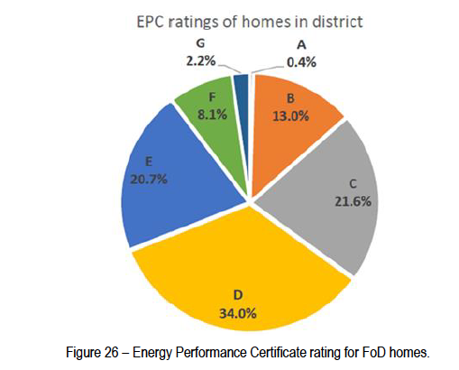
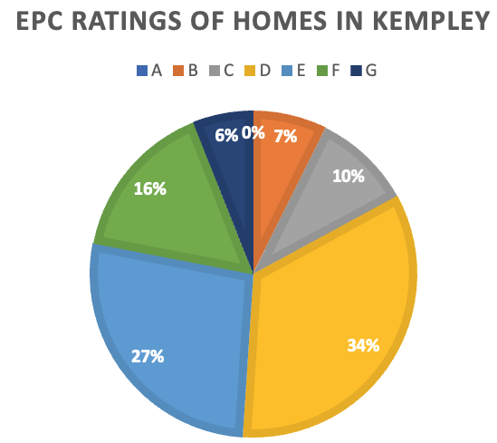
Rating A is best G is worst.
Energy Performance Certificates (EPC)
Forest of Dean District Council
Kempley Parish Council
Rating E/F/G –
Forest of Dean - 31%
Kempley Parish – 49%
A total of 70% of Kempley Properties have an EPC.

Slide 12
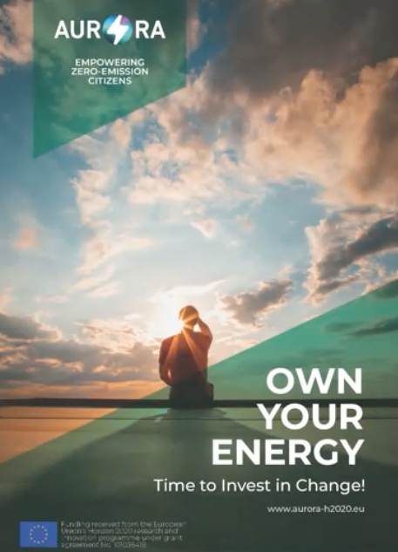
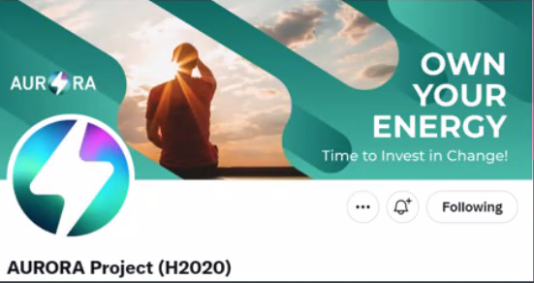
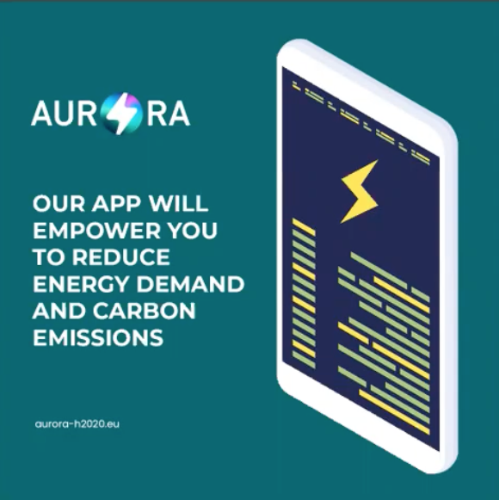
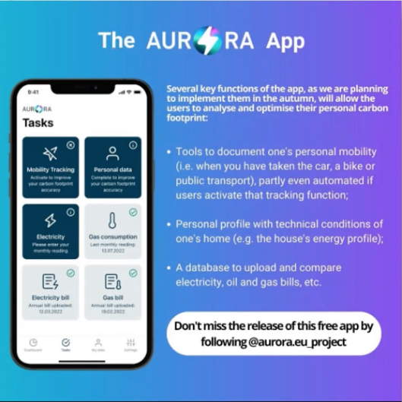
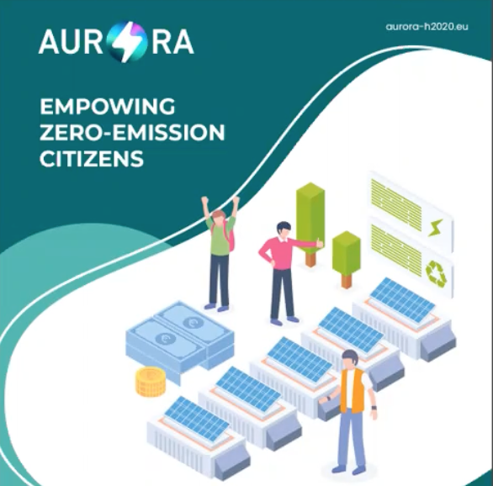
Project AURORA
Website https://www.aurora-h2020.eu
https://twitter.com/AURORA_H2020
Forest of Dean Pilot
Website https://www.aurora-h2020.eu/fod-home/

Slide 13
SHORT TERM
PUBLIC MEETING ON HOME ENERGY JOINTLY SPONSORED WITH NEWENT TRANSITION GROUP & BOB EARLL:
date 29th october 2022;
location – kempley village hall;
format – café format to share ideas; and
by invitation – maximum numbers 50.
CONTINUE TO PRESS FOR SUPERFAST BROADBAND
MEDIUM TERM
PROMOTE PROJECT AURORA THE NEW PHONE APP AND COMMUNITY INVESTMENT IN SOLAR ENERGY:
encourage participation; and
promote social media campaign with FODDC.
START MAPPING IMPROVEMENTS IN ENERGY EFFICIENCY FOR KEMPLEY ON PARISH ON-LINE:
track improvement from base line carbon emissions; and
share successes with community through the local What’s app group
LONG TERM
EXPLORE THE ESTABLISHMENT OF A COMMUNITY INTEREST COMPANY (CIC) FOR KEMPLEY TO FUND LOCAL IMPROVEMENTS AND:
Learn from best UK practice with Ecotricity & Western Power Distribution; and
Produce and sell energy local energy within the village.
NEXT STEPS

Slide 14
David McRaney - How Minds Change
The Surprising Science of Belief, Opinion, and Persuasion
“Once you move from viewing minds as objects which need to be shunted by the mechanical forces of evidence and argument, you can see the crucial truth that the answer to “how do minds change?” is “by themselves” (with sidehelpings of “usually slowly” and “by small increments ”).
“The groups that have had some success with changing opinions - such those developing the “Deep Canvassing”* technique for doorstep conversations around polarising issues - focus more on creating rapport and connecting issues to personal experience than on delivering facts or reasons. The forces internal to each mind are more powerful in creating lasting change than any external force.
“Each of us should have the humility to recognise that the best we can do is create fertile circumstances for other people to explore an issue.”
Abraham Lincoln quote, warning fellow temperance campaigners how to (fail) to persuade drinkers of the virtues of temperance:
“If you would win a man to your cause, first convince him that you are his sincere friend..
“[But if you] mark him as one to be shunned and despised, and he will retreat within himself, close all the avenues to his head and his heart.”
The Art of Persuasion
Changing People’s Minds
Just a few quotes

Slide 15
Kempley Daffodil Weekend
March 2023
Walks Leave St Edwards Church
09.45hrs; 10.15hrs; & 2pm
Daff & Ride Bus to see the wild Daffs
Market to your door – Saturday AM
Refreshment 10.30am to 4pm
Brochure – With a focus on Climate Change and its impact on our village

